Slide 1
VAE3 재현 실험

Slide 2
VAE3 with shared weight
Epoch : 2000
Learning rate : Linear decay [ 1e-2 , 1e-0 ]
Reconstruction : KL divergence = 5:1

Slide 3
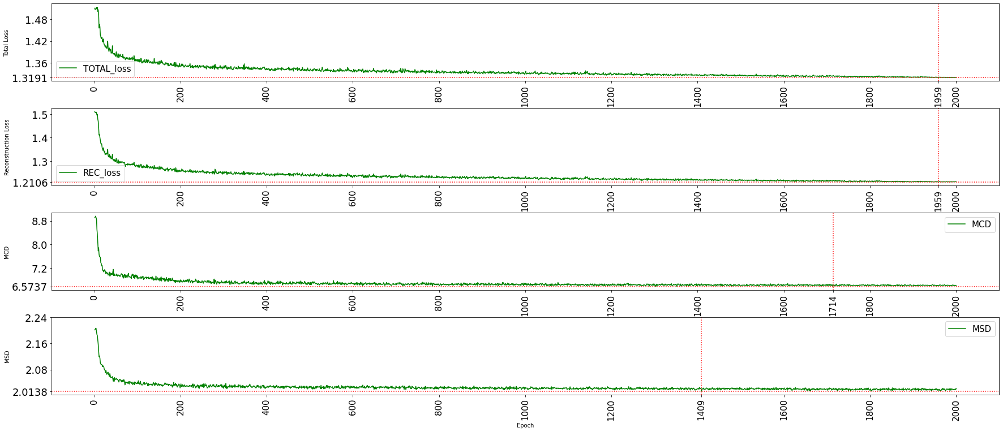
이전 실험

Slide 4
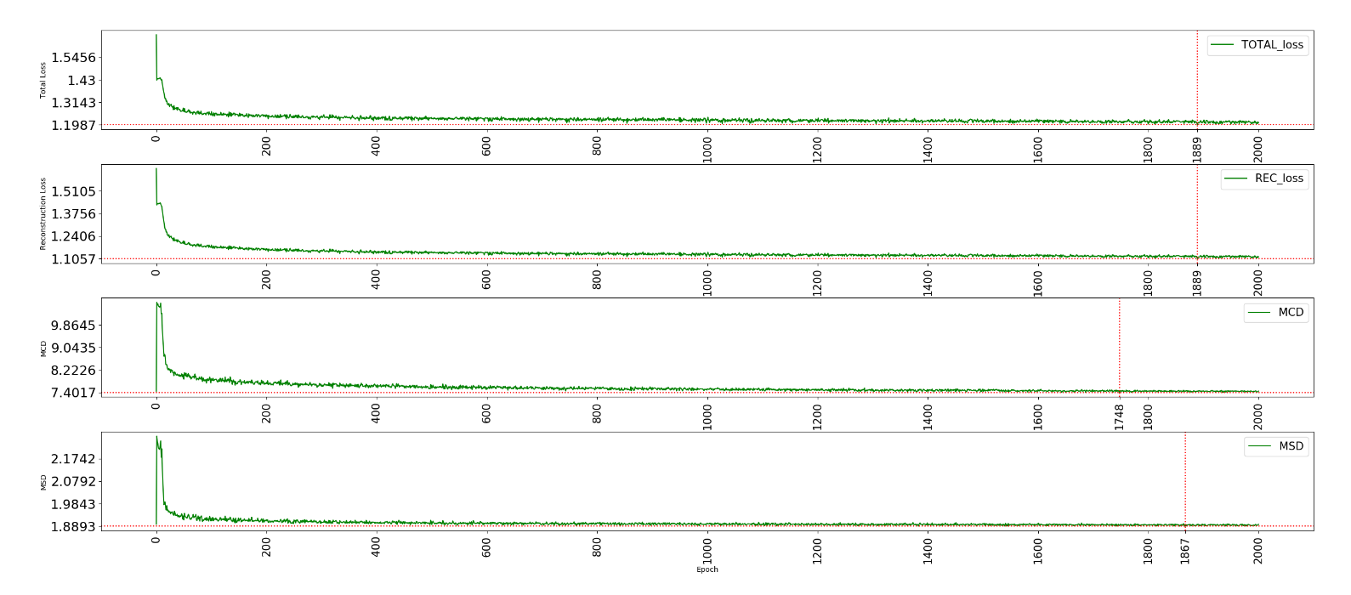
재현 실험

Slide 5
min value (epoch) exp type | Total loss | Reconstruction loss | MCD | MCD at 2000 | MSD
이전 실험 VAE3 (shared weight) | 1.3191 (1959) | 1.2106 (1959) | 6.5737 (1714) | 6.6065 (2000) | 2.0138 (1409)
재현 실험 VAE3 (shared weight) | 1.1987 (1889) | 1.1057 (1889) | 7.4017 (1748) | 7.4497 (2000) | 1.8893 (1687)

